Slide 1
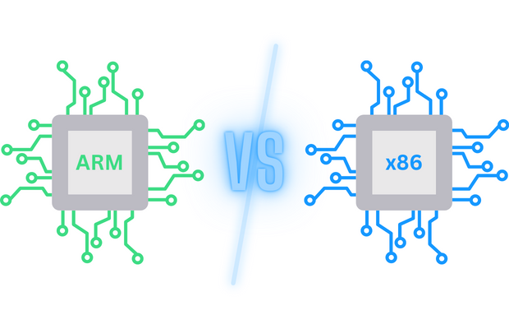
Comparing Hardware Performance Across ARM and x86 Architectures Using Computer Vision
Authors:
Johnny Acuna, Brian Garcia, Brandon Siu, Raymond Palacio

Slide 2
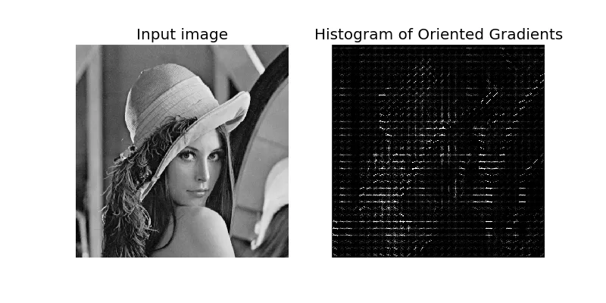
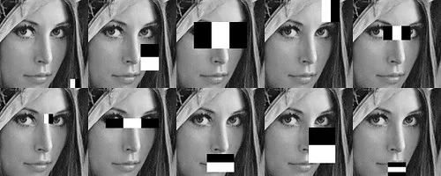
Motivation
Understanding the performance of Image Processing on computer architecture.
Collecting images and storing them in a folder as our training data.
hands-on experience with computer vision and machine learning concepts
Processing images using software written programs such as Python from the OpenCV libraries.
free and open-source. supports multiple programming languages like Python, C++, and Java.
Utilizing a USB webcam on Raspberry Pi 4 to automatically monitor and authenticate a person’s identity.
real-time image processing and implementation of facial recognition in dynamic scenarios. Applications across industries include Security: surveillance, Healthcare: Emotion detection, and Social Media: Facial filters or tagging features.

Slide 3
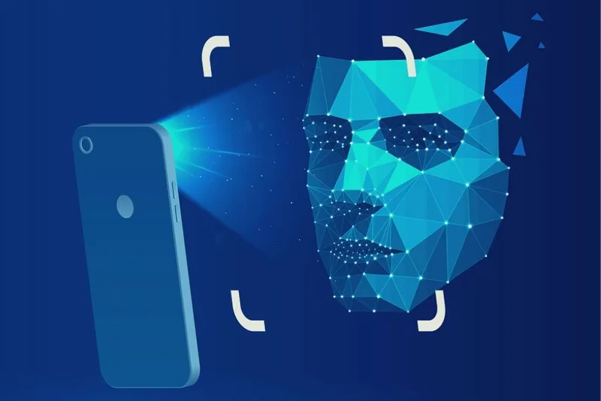
Advantages of the time tracking facial recognition system
Accuracy and Reliability - Ensures employees are physically present/ reduces “buddy punching” system (where another employee clocks in for another).
Robustness Against Spoofing - Robust anti-spoofing ensures that systems remain secure against masks, photos, or deepfake videos. Future advancements might include AI detection of physiological signs such as subtle heartbeat patterns or unique thermal signatures.
3D Facial Recognition - Traditional 2D recognition can struggle with accuracy. 3D mapping adds depth and structural analysis, significantly improving reliability. This evolution allows seamless, real-time applications in diverse scenarios for security systems.

Slide 4
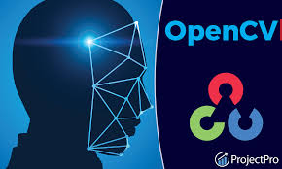
OpenCV
Haar Cascade
Detection algorithm that looks for features of a human
For computer vision it processes images through rectangular regions of the image
Histogram of Oriented Gradients (HOG)
This is a feature descriptor, helps extract useful information and removes noise
Rescales and converts images to vectors or array lengths
Helps calculate different sizes of the vectors
Convolutional Neural Networks
Applies sets of convolutional filters to extract features like edges, textures, or patterns
Filter convolves over the image and dot products are computed between the filter to produce feature maps
This helps extract key details of the images
Versions
x86: OpenCV version 4.10.0.84 and Python Version 3.10
ARM: OpenCV version 4.10.0.84 and Buster OS python Version 3.7
Notes:
Haar Caascade is an algorithm for detecting faces quickly and in real time
The recale is 64/128
A filter (kernel): A small matrix (e.g., 3x3 or 5x5) with values that are multiplied with overlapping patches of the input image.
The filter's weights are multiplied element-wise with the pixel values of the patch.
The final
HOG is a descriptor very specificlayer(s) of a CNN acts as a classifier, assigning probabilities to different classes (e.g., face or non-face).

Slide 5
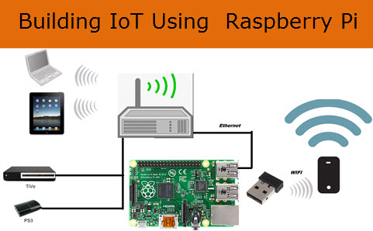
State of the Art in Image
Processing and Architectures
Raspberry Pi 4 (ARM)
Edge System: Processes data locally, minimizing latency and improving privacy.
Edge efficiency: low power usage (~3-6W) and sufficient performance for lightweight tasks.
Applications:
Smart cameras, home automation, real-time object detection in IoT
analyzing data on-site rather than uploading it to a remote data center
Lenovo Ideapad (x86 with AMD Ryzen 7 5800H and NVIDIA GPU):
High-performance architecture ideal for training and real-time AI applications.
Features:
NVIDIA GPU acceleration: Supports deep learning frameworks
High computational power for multi-threaded tasks and high-resolution image analysis.
Applications:
Security systems, research, and advanced real-time analytics.

Slide 6
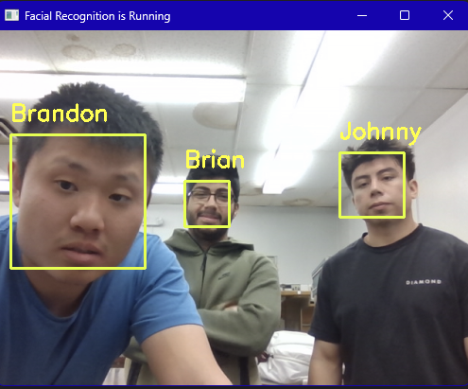
State of the Art Cont.
Facial Recognition Algorithms:
Haar cascades: Lightweight, rule-based algorithm for rapid detection.
Advanced algorithms:
CNNs (Convolutional Neural Networks): High-accuracy models widely adopted.
YOLO: Real-time detection in advanced surveillance systems.
MTCNN: Popular in smartphones for face alignment and unlocking.
Trends in Current Use:
Edge Systems (ARM):
Prioritize latency reduction
privacy
energy efficiency
High Performance Systems (x86):
Focus on scalability
speed
demanding workloads

Slide 7
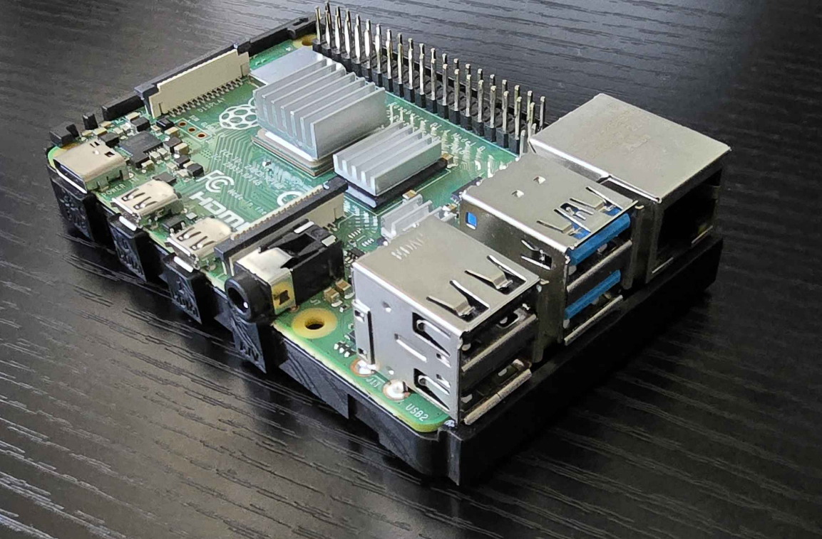
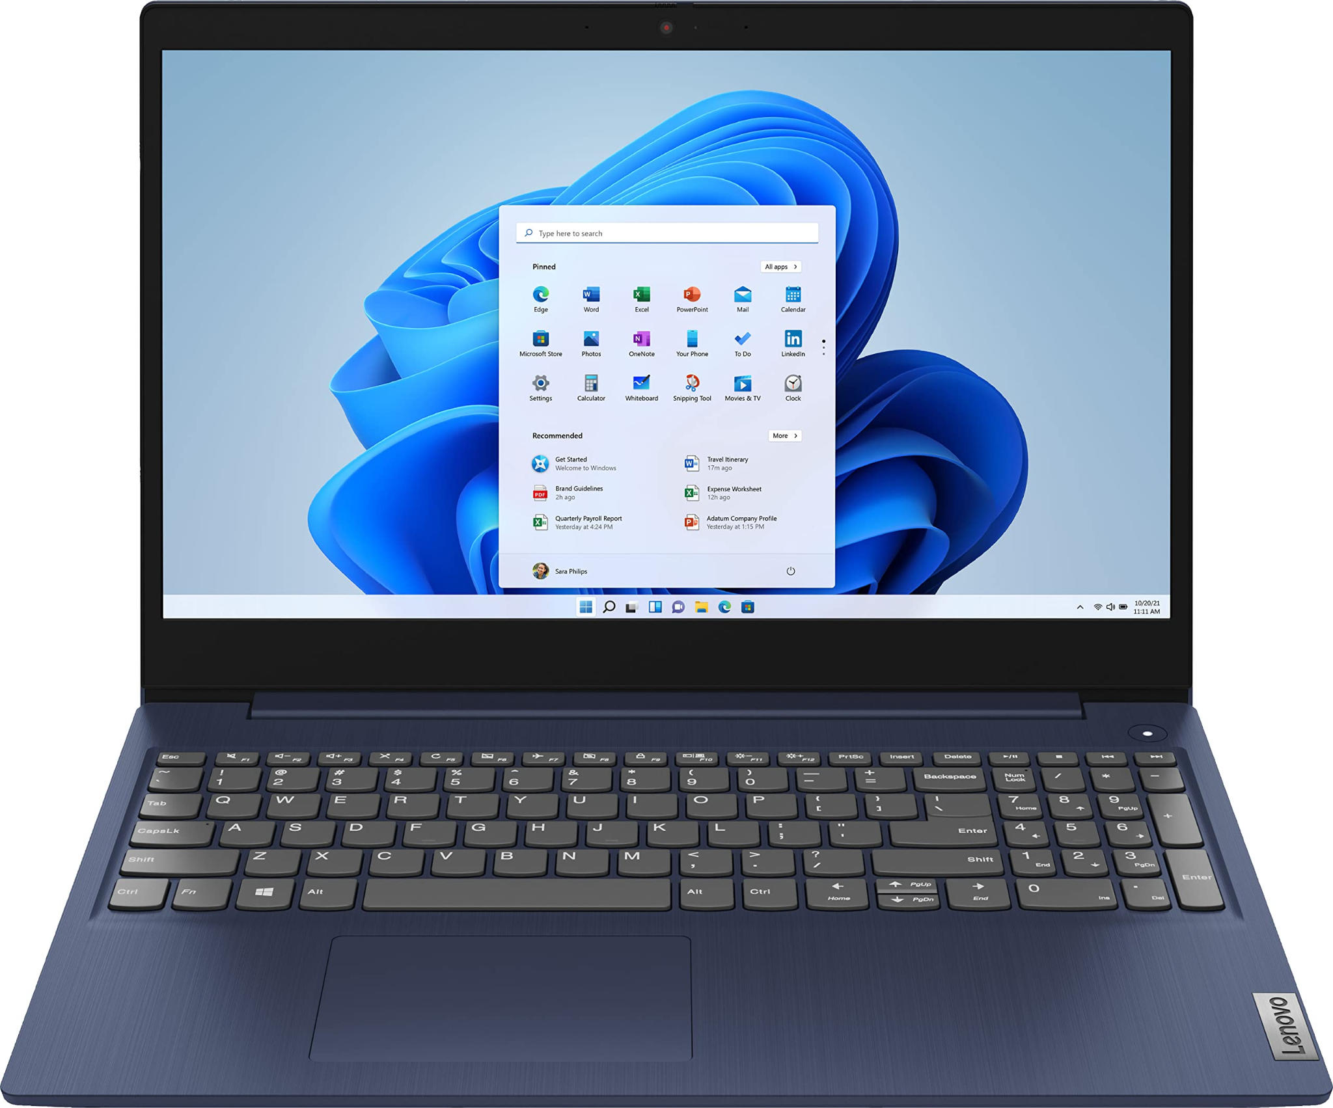
Systems
Raspberry Pi 4
Processor: (BCM2712) 1.8 GHz quad-core Cortex-A76
GPU: VideoCore VII, supports dual 4K60 HDMI
Memory: 4GB LPDDR4X
Connectivity: USB 3.0
Lenovo Ideapad Gaming
Processor: Ryzen 5800H 8 core at 3.2 GHz
GPU: RTX 3050 4GB GDDR6 1768 cuda cores at 1.5 GHz
Memory: 16GB DDR4-3200
Desktop Computer
Processor: Intel Core I7 13700k 16 core processor at 5.2 GHz
GPU: RTX 3080 10GB GDDR6x 8704 cuda cores at 1.4GHz
Memory: 32GB DDR4-3200

Slide 8
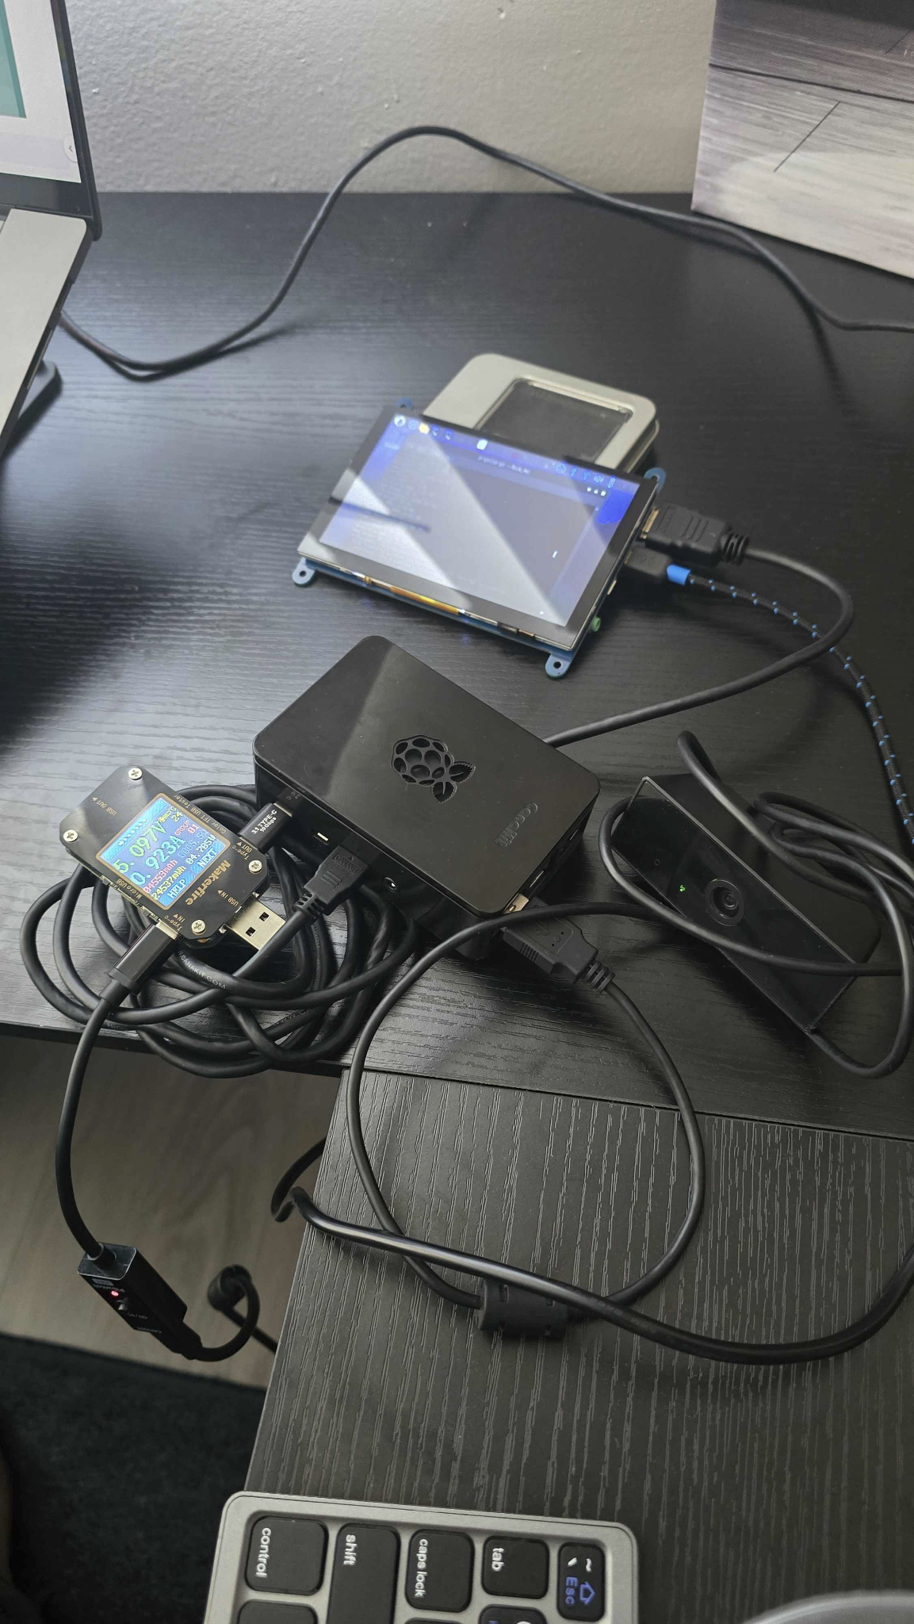
Raspberry Pi System
Software:
Raspberry Pi OS installed(Linux based)
First installed OpenCV system wide
In a python environment(3.10), we installed dlib(library with tools relating to image processing) and imutils(python library aids with OpenCV).
Install face_recognition library
Once we have all of that, we first run the training model file and then followed by the facial recognition file.
We used the same algorithm across all devices
Hardware:
- Rpi4
- Mini monitor
- USB Webcam
- Makerfire multimeter

Slide 9
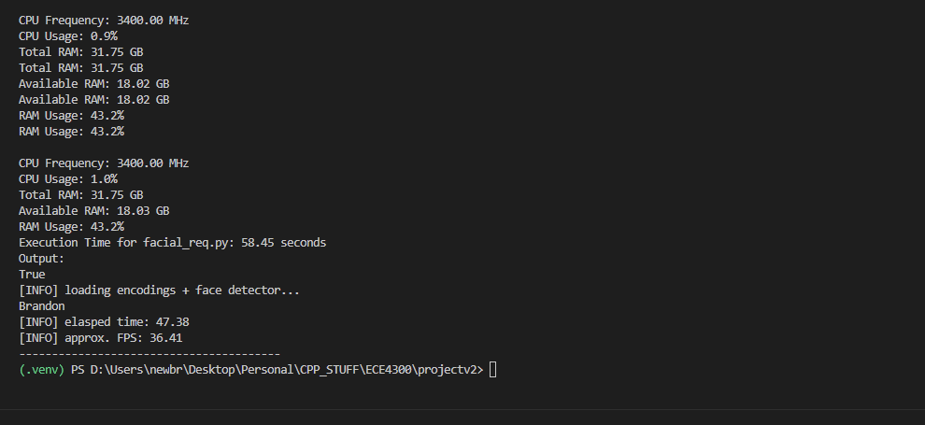
Performance Evaluation
Energy Efficiency:
Raspberry Pi 4 (5.02W): highly power-efficient, ideal for low-power, edge computing.
Intel i7 (50.2W) and Ryzen 5800H (18W): consume significantly more power RP4 but less than GPUs
GPUs (RTX 3050: 46W, RTX 3080: 115.5W): have higher power demands but excel in performance.
Performance (FPS):
Raspberry Pi 4 (2.84): is suitable for lightweight tasks
while Intel i7 (14fps) and Ryzen 5800H (10fps) are faster but consume more power.
GPUs (RTX 3050: 25 fps, RTX 3080: 39 fps) offer the highest FPS, optimized for parallel workloads.
(Note: all numbers are average over 10 trials each)

Slide 10
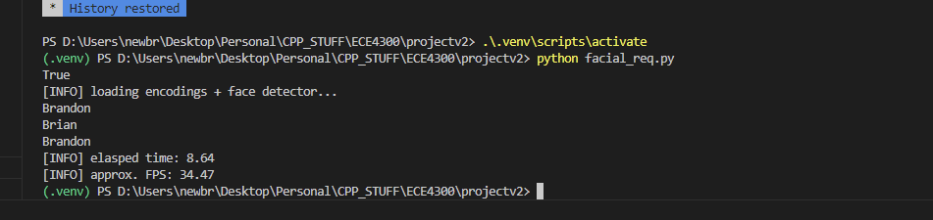
Performance Evaluation Cont.
Training Time:
Raspberry Pi 4 takes the longest (168s)
Intel i7 (8.8s) and Ryzen 5800H (11.6s) offer faster training times than RP4
GPUs dramatically outperform CPUs (RTX 3050: 4.9s , RTX 3080: 2.3s) with the least average training time
Memory Usage:
Raspberry Pi 4 use the least amount of RAM (0.96 GB)
Intel i7 (11.6GB) and Ryzen (8.8GB) systems use the most RAM due to sequential processing
GPUs use less RAM (RTX 3050: 0.5GB, RTX 3080: 1.5GB) leveraging parallel cores to perform parallel processing for efficient memory use.
Best Use Case:
Raspberry Pi 4 is best for low-power, small-scale applications.
Intel and Ryzen CPUs excel in multi-threaded tasks,
while GPUs are ideal for high-performance, real-time image processing.

Slide 11
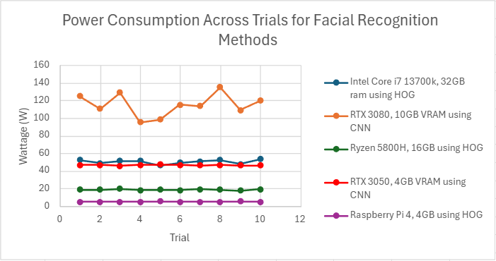
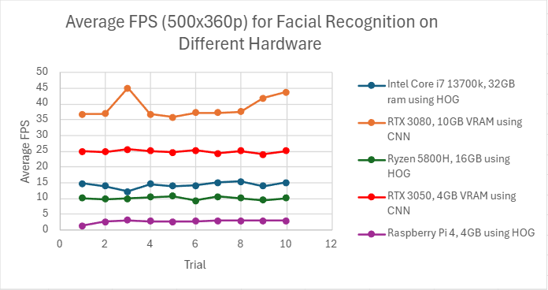
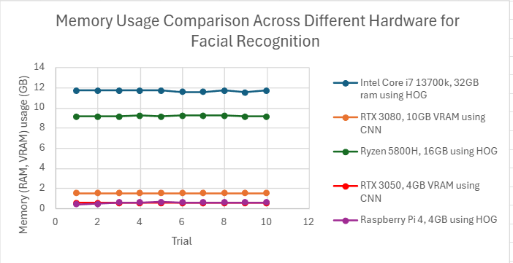
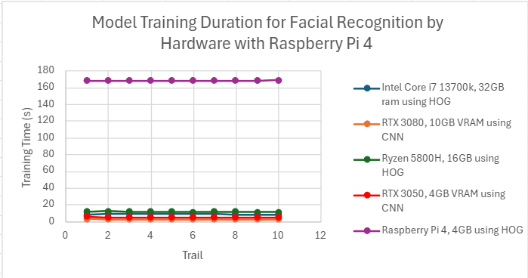
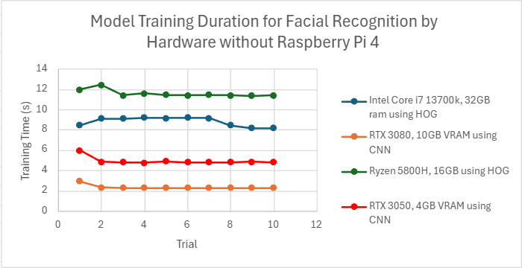
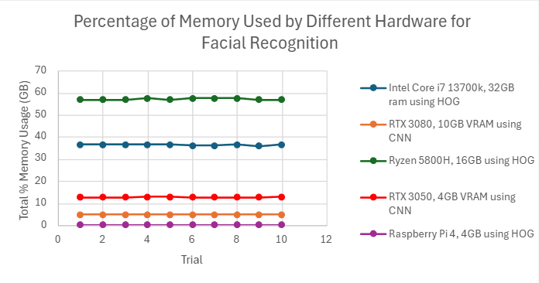
Graphical Data

Slide 12
Concluding Remarks
Key Findings:
ARM Architecture (Raspberry Pi 4): Limited FPS and training time, with higher power efficiency than x86
x86 Architecture (Intel and AMD CPU): Higher fps and faster training times, with cost of high power consumption
GPU vs CPU (RTX 3050/RTX3080): outperform CPUs providing faster FPS and reduced training time with high power
Power Efficiency: Raspberry PI 4 has most impressive power efficiency, good for embedded applications
Performance Implications:
ARM (Raspberry Pi):
Ideal for low-power applications where fps is not critical
x86 (Intel/AMD CPU)
Excels in high-performance, requiring faster facial recognition procession
GPUs (RTX with x86 architecture)
Highest performance for demanding real-time cognition tasks.

Slide 13
Future Works
Expand Benchmarks
Include additional ARM-based devices (Surface Pro, MAC) to further explore ARM’s potential in facial recognition/ML
Optimized Algorithms
Investigate optimizations in facial recognition to improve performance on lower-end hardware like Raspberry Pi
Real-World Applications
Test systems in real-world environment including security, healthcare, and offices
Evaluate practicality of ARM vs x86 facial recognition systems in real-world
Edge Computing Integration:
Explore integration of Raspberry Pi and similar low-powered ARM devices for real-time facial recognition
Implement optimized facial recognition algorithm tailored for ARM architecture

Slide 14
References
R. A. Asmara, M. Ridwan, and G. Budiprasetyo, "Haar Cascade and Convolutional Neural Network Face Detection in Client-Side for Cloud Computing Face Recognition," 2021 International Conference on Electrical and Information Technology (IEIT), 2021, pp. 1–6, doi: 10.1109/IEIT53149.2021.9587388.
C. Rahmad, R. A. Asmara, D. R. H. Putra, I. Dharma, H. Darmono, and I. Muhiqqin, "Comparison of Viola-Jones Haar Cascade Classifier and Histogram of Oriented Gradients (HOG) for Face Detection," IOP Conference Series: Materials Science and Engineering, vol. 732, p. 012038, 2020, doi: 10.1088/1757-899X/732/1/012038.
Tim, "Face Recognition With Raspberry Pi and OpenCV," Core Electronics, Oct. 16, 2024. [Online]. Available: https://core-electronics.com.au/guides/face-identify-raspberry-pi/#Down. [Accessed: Nov. 27, 2024].

